Slide 1
JET Audio Encoder
Taylor Autry
Eric Addison
Josh Musick

Slide 2
Overview
Compression Pipeline
Filter Bank
Modified Discrete Cosine Transform (MDCT)
Byte Bufferizers
Huffman Encoder
Serialization
Results
Audio Samples

Slide 3
Audio Compression Pipeline
Input Audio File (wav)
Modified Discrete Cosine Transform (MDCT)
Filter Bank
Line Byte Bufferizer
Sub Band Byte Bufferizer
Huffman Encoder
Serialize Data Stream
Output Compressed File (jet)

Slide 4
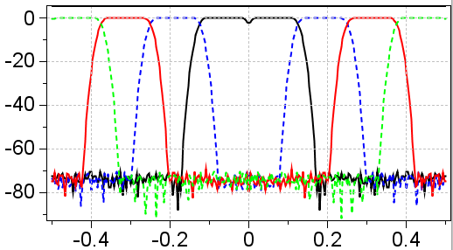
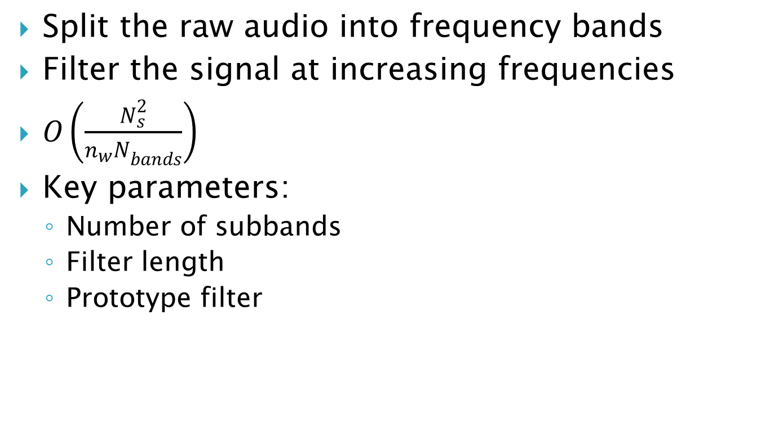
Filter Bank Step
Split the raw audio into frequency bands
Filter the signal at increasing frequencies
$O\left(\frac{N_{s}^{2}}{{n_{w}N}_{bands}}\right)$
Key parameters:
Number of subbands
Filter length
Prototype filter

Slide 5
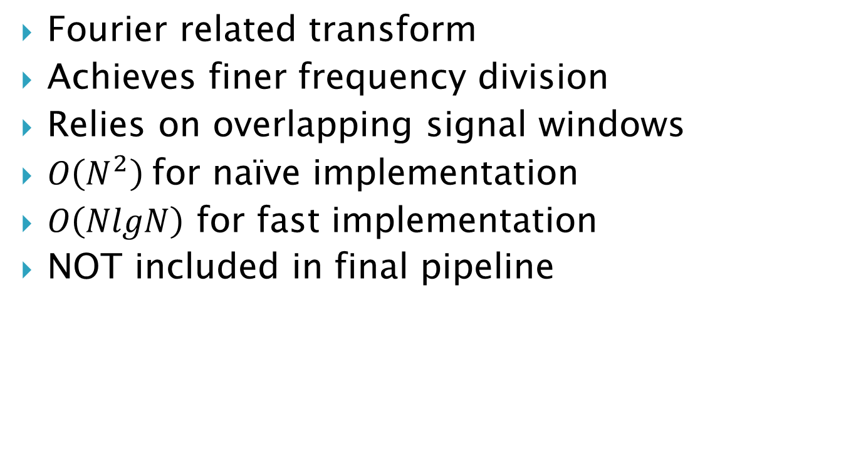
Modified Discrete Cosine Transform
Fourier related transform
Achieves finer frequency division
Relies on overlapping signal windows
$O\left(N^{2}\right)$for naïve implementation
$O\left(NlgN\right)$ for fast implementation
NOT included in final pipeline

Slide 6
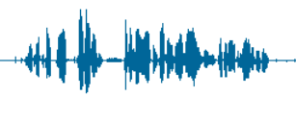
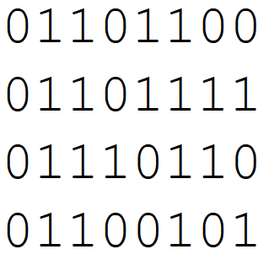
Byte Bufferizers
Transformation from signal to byte domain
Store the floats as byte-limited integers
Adaptive Version
Identify local min/max for each incoming window
Psycho-Acoustic Model
Exploit human physiology and perception to reduce the precision of and/or eliminate certain components of the signal
*** Primary source of compression!!!
Our model: cut the byte-depth outside passband

Slide 7
Huffman Encoder

Slide 8
Data Serialization

Slide 9
Results - Variables
We ran our compressor on nine wav files
2500 tests per file!
Adjustable parameters:
Raw audio signal window length
Filterbank prototype filter
Filterbank filter length
Psycho-acoustic model passband frequencies
Use adaptive byte bufferizers?
Use adaptive Huffman Encoding?

Slide 10
Results - Metrics
We ran our compressor on nine wav files
Recorded metrics:
Compression ratio
RMS error
Compression time
Decompression time

Slide 11
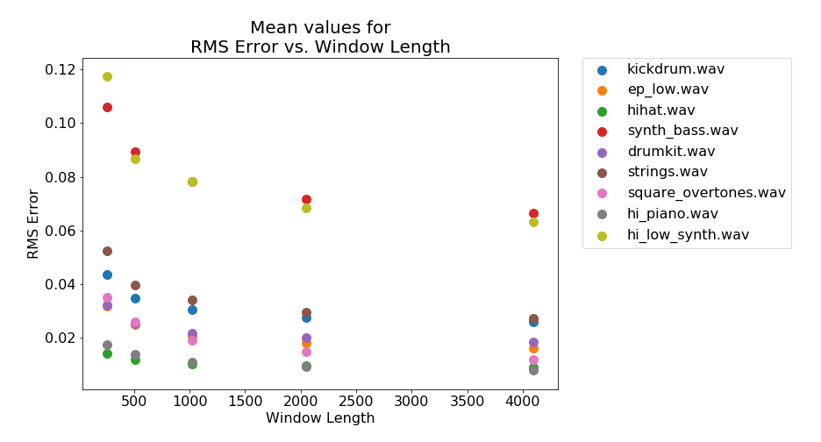
Results

Slide 12
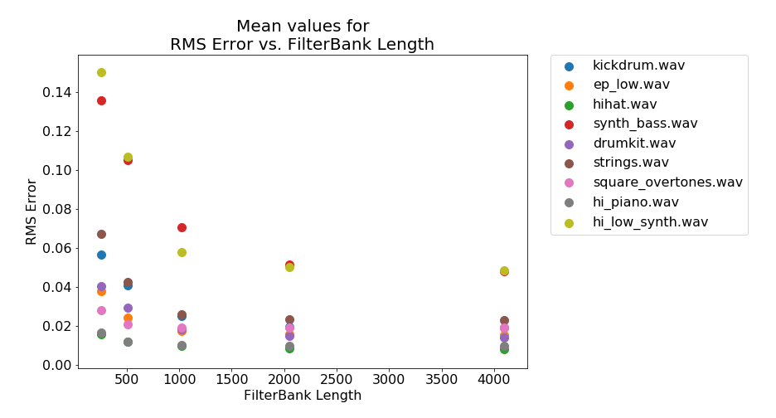
Results

Slide 13
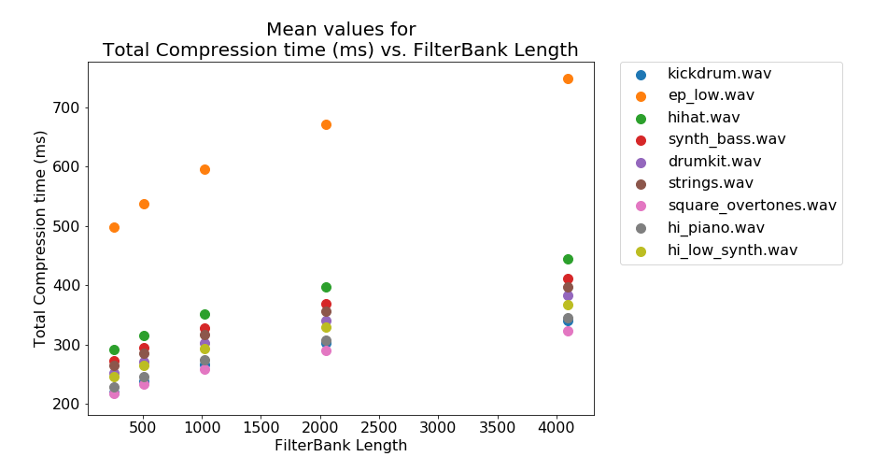
Results

Slide 14
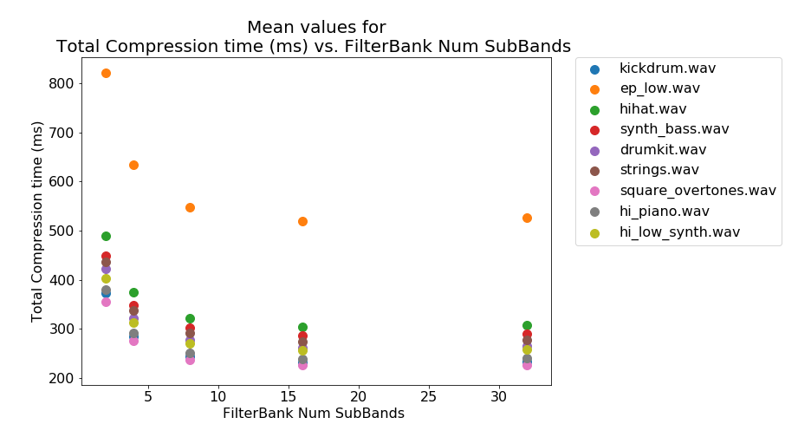
Results

Slide 15
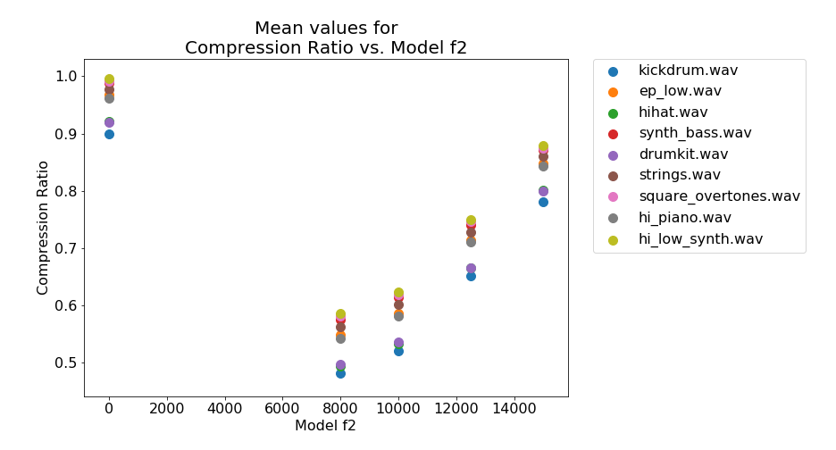
Results

Slide 16
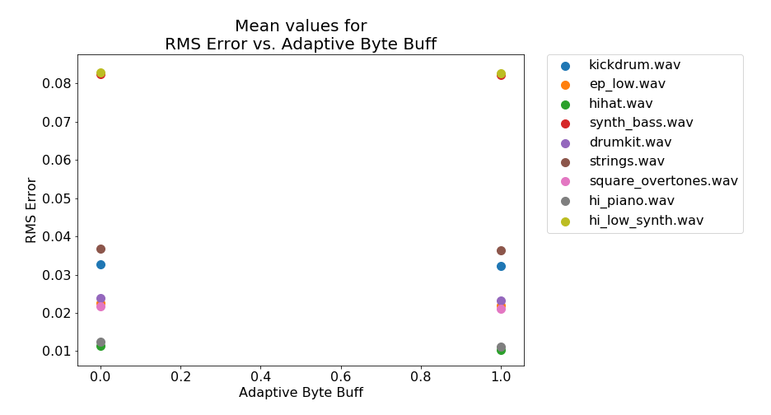
Results

Slide 17
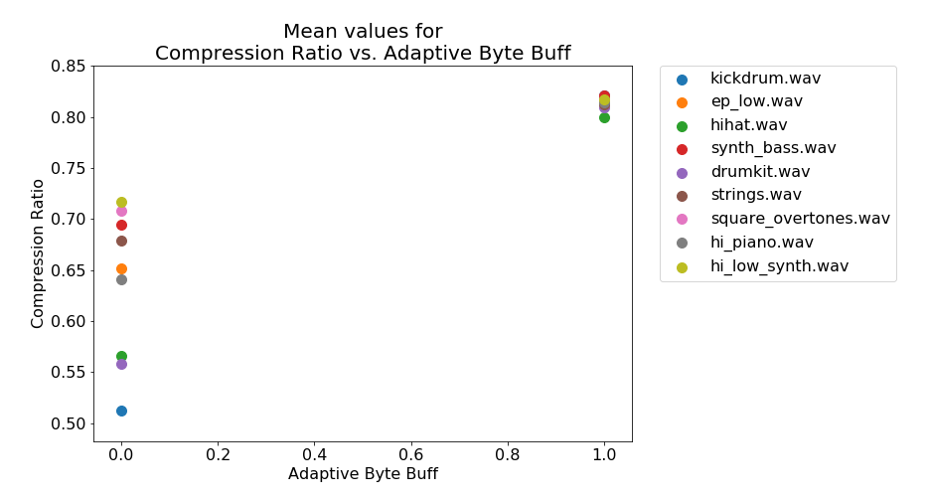
Results

Slide 18
Audio Samples
drumkit.wav
drumkit_bestRMS.wav
(0.004, 0.96, 512ms)
drumkit_bestCompression.wav
(0.037, 0.2, 192ms)
drumkit_bestDecompTime.wav
(0.044, 0.4, 174ms)

Slide 19
Summary
Compression Pipeline
Filter Bank
Modified Discrete Cosine Transform (MDCT)
Byte Bufferizers
Huffman Encoder
Serialization
Results
Audio Samples

